Slide 1
Q1: Find out if there is a difference between Subscriber/Customer in daily routine

Slide 2
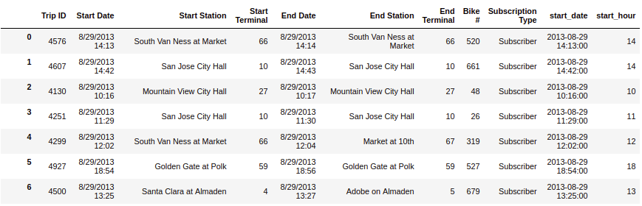
Step 1
Transform the Start Date to datetime type and extract the hour from it

Slide 3
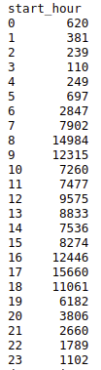
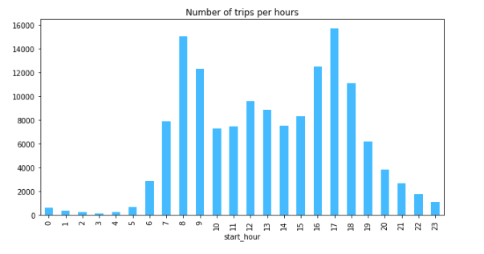
Step 2
Count how many trip started in each hour and create a bar chart from it

Slide 4
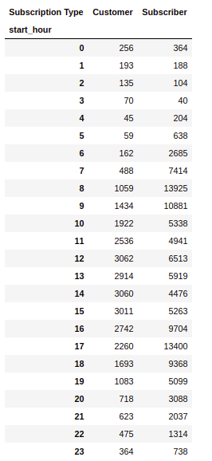
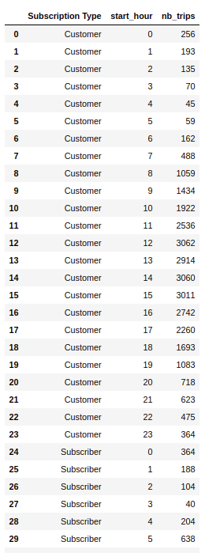
Step 3
Count how many trip started by hour and by Subscription Type
Reshape (pivot) the table to prepare for plotting

Slide 5
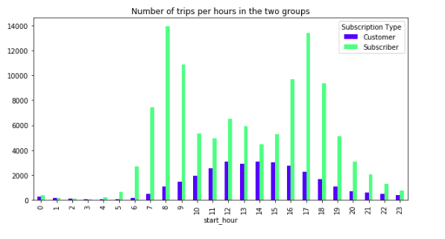
Step 4
Plot the number of trips by hour and by Subscription Type

Slide 6
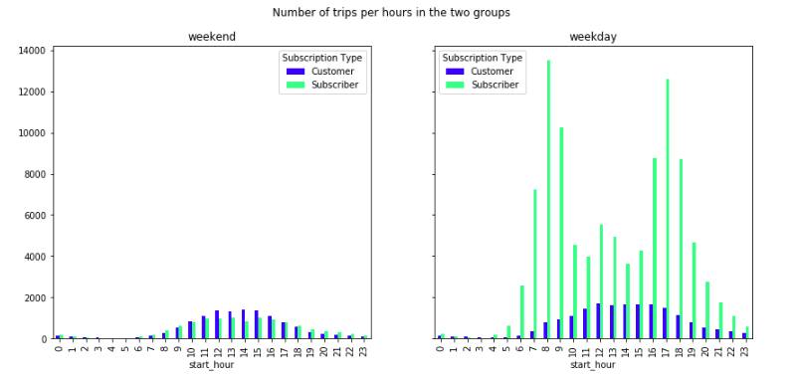
Step 5
Do the same for weekends and weekdays separately

